Slide 1
DOM

Slide 2
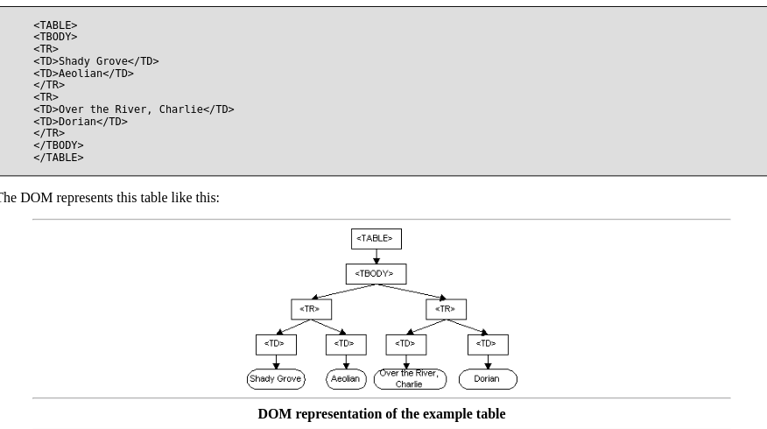
What is it?
Notes:
The Document Object Model (DOM) is an application programming interface (API) for HTML and XML documents. It defines the logical structure of documents and the way a document is accessed and manipulated.
It is a standard

Slide 3

HTML DOM
Notes:
JavaScript can change all the HTML elements in the page
JavaScript can change all the HTML attributes in the page
JavaScript can change all the CSS styles in the page
JavaScript can remove existing HTML elements and attributes
JavaScript can add new HTML elements and attributes
JavaScript can react to all existing HTML events in the page
JavaScript can create new HTML events in the page
The HTML DOM is a standard object model and programming interface for HTML. It defines:
The HTML elements as objects
The properties of all HTML elements
The methods to access all HTML elements
The events for all HTML elements
In other words: The HTML DOM is a standard for how to get, change, add, or delete HTML elements.

Slide 4
Example 1
getElementById
The most common way to access an HTML element is to use the id of the element.
innerHTML property
The easiest way to get the content of an element is by using the innerHTML property.

Slide 5
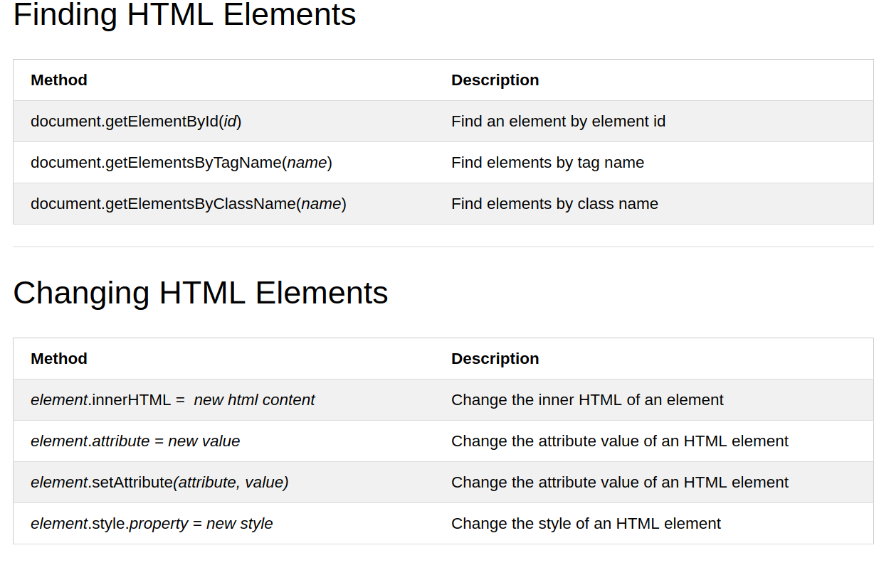
HTML DOM

Slide 6
Find Elements
https://www.w3schools.com/js/tryit.asp?filename=tryjs_dom_getelementbyid
https://www.w3schools.com/js/tryit.asp?filename=tryjs_dom_getelementsbytagname2

Slide 7
More
https://www.w3schools.com/js/tryit.asp?filename=tryjs_dom_getelementsbytagname
https://www.w3schools.com/js/tryit.asp?filename=tryjs_dom_getelementsbyclassname

Slide 8
Exercises
https://www.w3schools.com/js/js_htmldom_elements.asp
https://www.w3schools.com/js/js_htmldom.asp

